Slide 1

Predicting Heart disease based on genetic, lifestyle and clinical data using machine learning.

Slide 2
Group :08
Supervised by: Prof. Dr. Md. Asraf Ali
Course name: Machine learning
Section: E
NAME | ID
ABRAR SHAKIL OISHIK | 22-46257-1
FOYSAL AHMED FAHAD | 22-47076-1
ABDULLAH RAHMAN IRFAN | 22-46877-1

Slide 3

Table of contents
Problem background
Motivation
Objective
Methodology
Result & Discussion
Conclusion
References

Slide 4

Problem background
CVD accounts for ~31.5% of all global deaths (~20.5 million annually).[1]
WHO projects a rise to 24.2 million deaths per year by 2030.[1]
Heart disease type:
1. Coronary Artery Disease (CAD)
2. Stroke
3. Heart Failure
4. Hypertension
CAD alone is a leading cause due to its high mortality rate

Slide 5
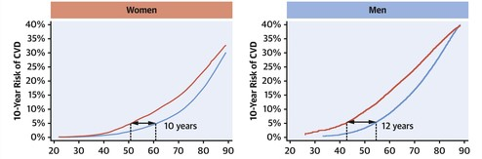
Problem background
Challenges in Early Detection :
Many cardiovascular conditions are asymptomatic until late stages.
Diagnosis often happens after irreversible damage.
Delayed diagnosis leads to :Higher mortality, Complex and costly treatments
Traditional screening methods rely on clinical symptoms and limited parameters.

Slide 6
Problem background
Gaps in Existing Solutions:
Why Machine Learning?
Most ML models use only clinical features, ignoring: Genetic predisposition, Lifestyle factors.
Challenges include:
Imbalanced datasets
Limited feature selection
Inconsistent model accuracy
Poor generalizability to new data
ML can uncover complex patterns in large, multi-dimensional datasets.
ML model capable of integrating: Clinical metrics, Genetic factors, Lifestyle data.
Helps in early detection, personalized risk prediction, and treatment planning.

Slide 7
Motivation
Research Goals and Motivation
Our Solution:
Test 7 advanced ML models:
Improve early prediction of CVD using holistic datasets.
Benchmark various ML models to determine best-fit algorithms.
Bridge research gap by:
1. Using diverse and balanced features
2. Ensuring model interpretability and accuracy
3. Providing insights that are clinically actionable
Logistic Regression
Naïve Bayes
K-Nearest Neighbors
Decision Tree
Random Forest
Support Vector Machine
XGBoost

Slide 8


Project analysis slide 3
Objective
The primary objective of the study is to develop a robust ensemble framework that utilizes machine learning techniques to improve the prediction accuracy of cardiovascular diseases.
Combine multiple machine learning algorithms in a stacked ensemble model to leverage their strengths and improve prediction performance.
We have used the dataset from Kaggle heart disease which is one of the online available largest datasets for cardiovascular diseases individuals.

Slide 9
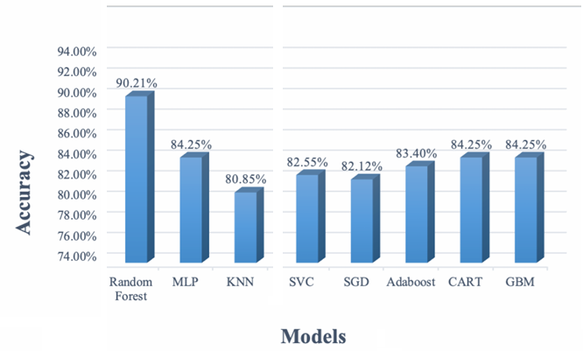
Project analysis slide 3
Literature Review
Researchers are using a range of approaches and algorithms to predict cardiovascular disease. Over the years, several types of research on the prognosis of cardiovascular illness have been carried out.
Research Gaps:
Small datasets and limited generalizability in prior studies.
Few practical applications for resource-limited settings.

Slide 10
Project analysis slide 3
Literature Review
S. No. | Author (s) | Approach | Dataset | Accuracy
1 | Azimi Lamir et al. (2025) | Random Forest, KNN, Logistic Regression | Heart Disease dataset (303 samples, 14 features) | 91.00%
2 | Hasan et al. (2025) | XGBoost, Random Forest, Decision Tree, KNN, SVM, Naive Bayes, Logistic Regression, Adaptive Boosting, Linear Regression | Physiological indicators dataset | XGBoost: 99%
3 | Abdulrakeeb et al. (2025) | Bagged Decision Trees with feature weighting | Coronary Heart Disease dataset | 97.1%
4 | Modak et al. (2022) | Random Forest, Multilayer Perceptron, Bayes Net Naïve Bayes | Cleveland, Hungarian, Switzerland, Long Beach, Statlog | 87.70%
5 | Atallah et al. (2019) | (SGD)Classifier, K- Nearest Neighbor Classifier, Random Forest Classifier, Logistic Regression Classifier | Cleveland | 90%
6 | Nguyen et al. (2021) | Naive Bayes, Logistic Regression, SVM, Decision Trees | Cleveland | 84.83%
7 | Miah et al. (2023) | Comparative analysis: XGBoost, LightGBM, etc. | Myocardial Infarction dataset | 92.72%
8 | Tiwari et al. (2023) | Ensemble framework with ExtraTrees, Random Forest, XGBoost | Combined datasets (Hungarian, Cleveland, etc.) | 92.34%

Slide 11
Data Collection and Preprocessing
Dataset Overview
Used a heart disease dataset with 1,025 patient records, including 14 features such as age, blood pressure, cholesterol, and ECG results.
The dataset is balanced with no missing values, containing demographic, clinical, and categorical variables.
Preprocessing Steps
Checked for missing values and confirmed none present
Encoded categorical variables using label encoding
Applied Min-Max normalization for feature scaling
Detected and managed outliers via box plot analysis
Split data into 70% training and 30% testing sets

Slide 12
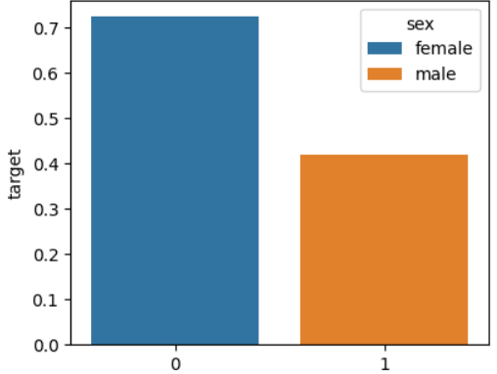
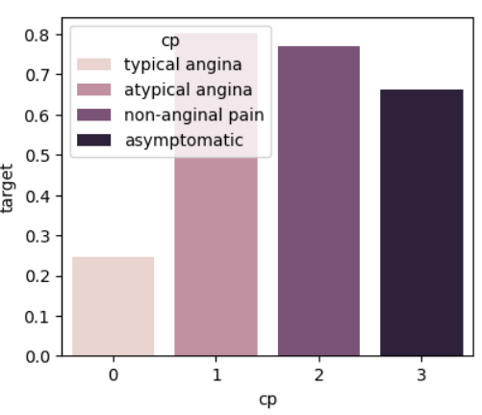
Project analysis slide 3
Proposed Methodology
Data Description
The dataset was compiled by merging five prominent CVD datasets that were previously available individually named Hungarian, Cleveland, Long Beach VA, Switzerland & Statlog (Heart) Dataset
Demographics: Age, sex.
Clinical Measurements: Cholesterol, resting blood pressure (BP), and maximum heart rate.
Symptoms: Chest pain type, exercise-induced angina.
Other Indicators: Fasting blood sugar, ST slope, and oldpeak (ST depression induced by exercise) .

Slide 13
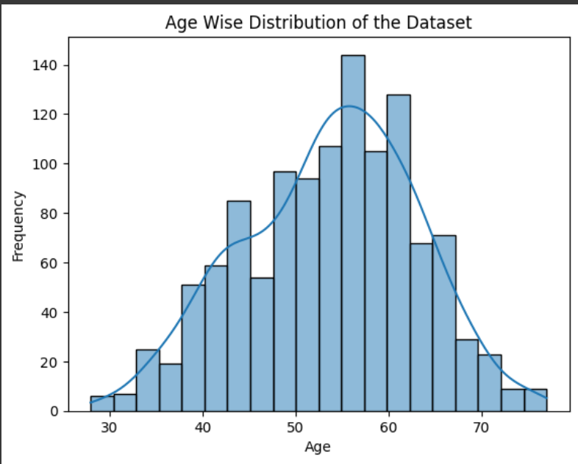
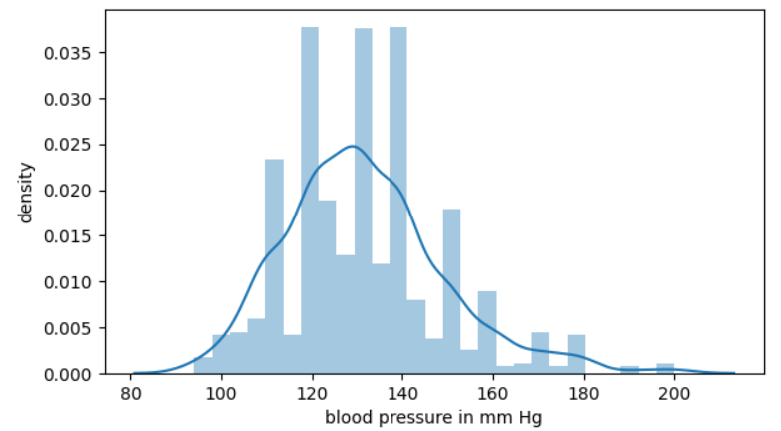
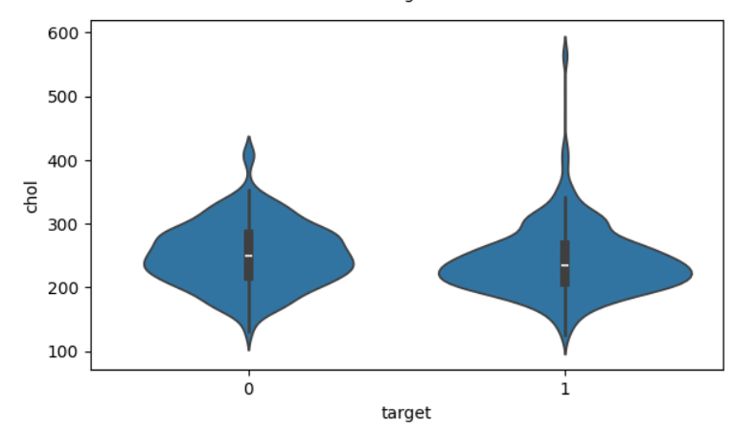
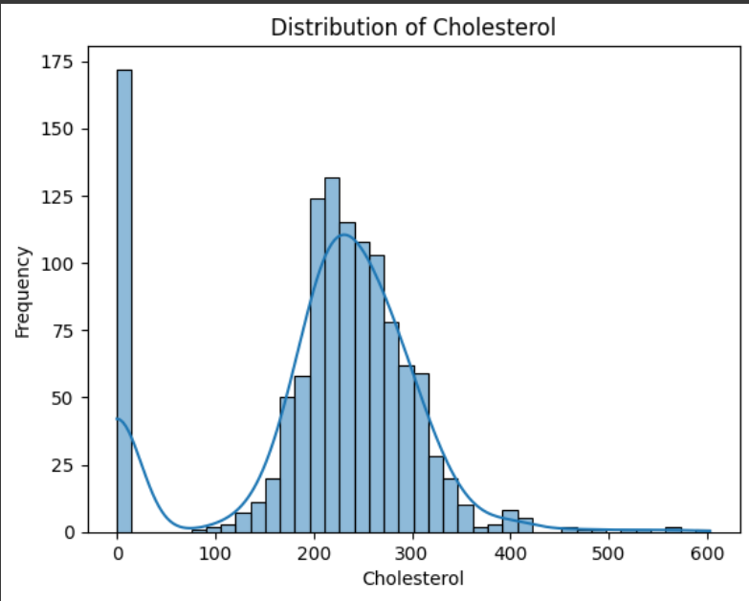
Project analysis slide 3
Proposed Methodology
Feature Analyze

Slide 14
Project analysis slide 3
Proposed Methodology
Data Preprocessing
To ensure data quality and model performance, the following preprocessing steps were applied:
Categorical Variables : Some features in the dataset are categorical These categorical variables were encoded using Label Encoding, depending on the algorithm
Scaling: Standard Scaler an MinMax Scaler was used to normalize features, ensuring uniform feature scaling.
Dimensionality Reduction: Exploratory Data Analysis (EDA) was applied to visualize data patterns and reduce complexity.
Feature Selection
Recursive Feature Elimination (RFE):
Iteratively removes less important features based on model performance.
Ensures the final model focuses on the most significant predictors.

Slide 15
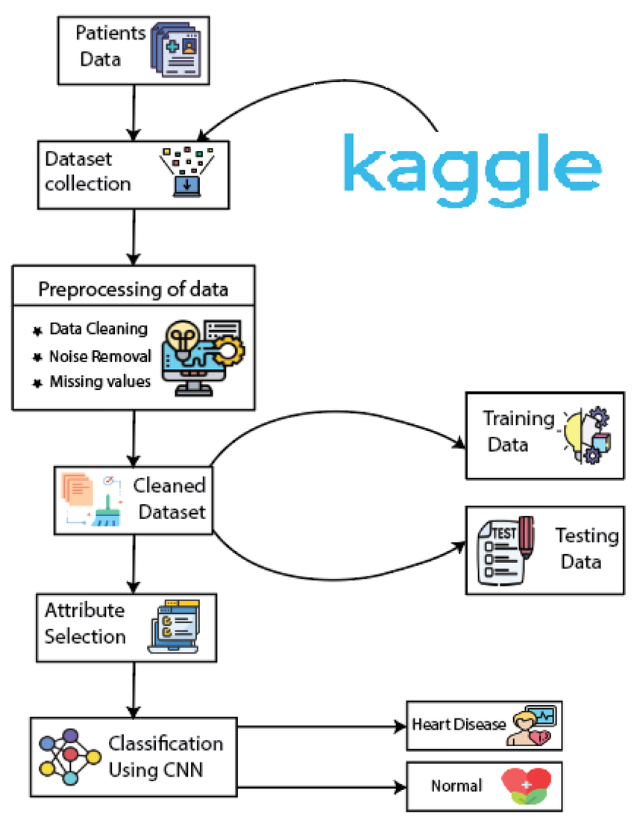
Project analysis slide 3
Proposed Methodology
Model Development
Figure : The proposed ensemble framework for heart disease prediction

Slide 16
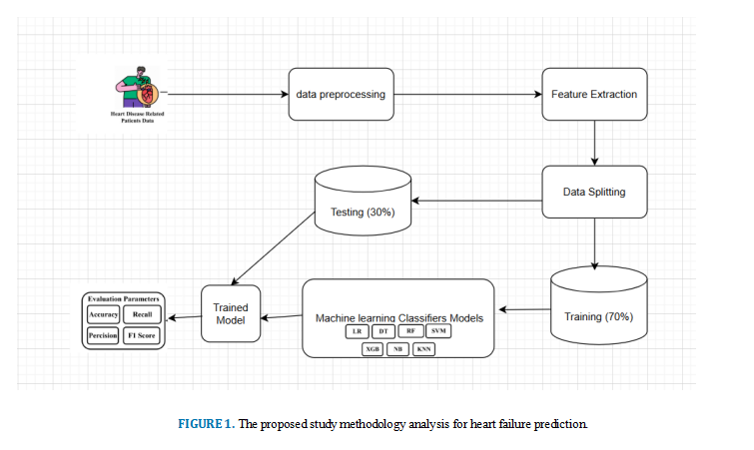
Project analysis slide 3
Proposed Methodology
Proposed Model
Figure :The architecture of proposed ensemble model

Slide 17
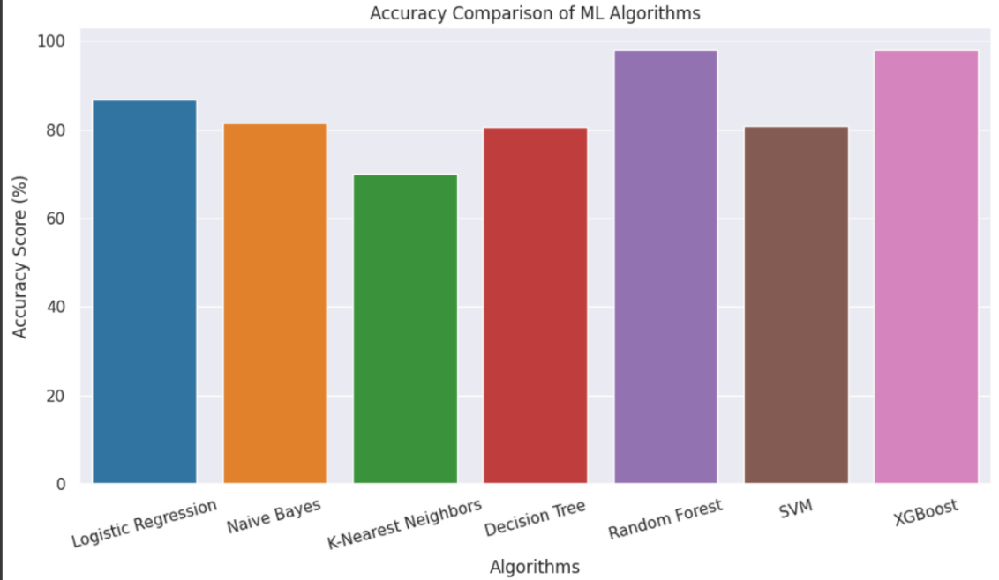
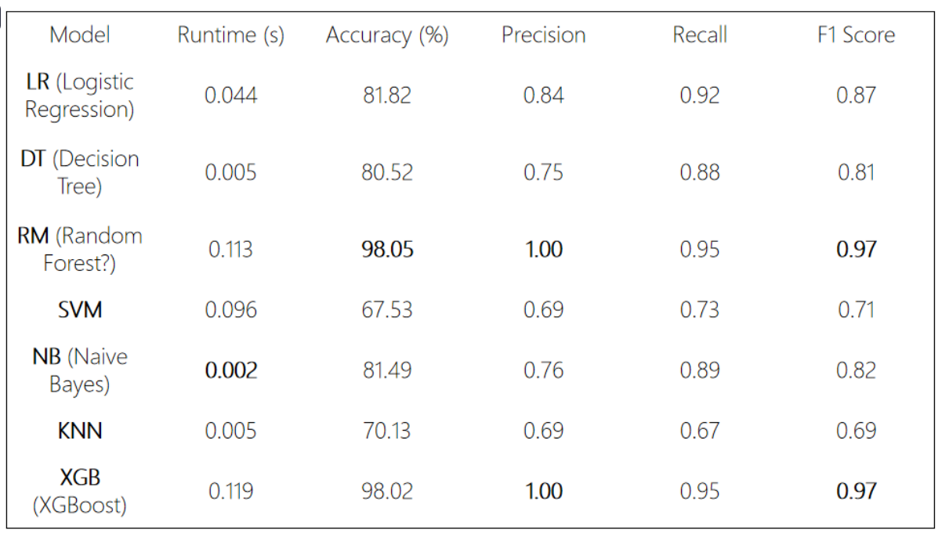
Project analysis slide 3
Result
Best Performing Models:
Random Forest (RM) and XGBoost (XGB):
Top accuracy (~98%)
Perfect precision (1.00)
Excellent F1 score (0.97)
High recall (0.95)
Slightly higher runtime (~0.11s), but worth it given the performance.
Fastest Model:
Naive Bayes: Extremely fast (0.002s) with decent overall performance:
Accuracy: 81.49%
F1 Score: 0.82

Slide 18
Project analysis slide 3
Result
Confusion Matrix and Comparative Analysis
Comparison with Existing Models
Confusion Matrix Insights
Our proposed Random Forest model achieved 98.02% accuracy, outperforming previous studies with accuracies ranging from 86.6% to 96.28%. [4] [5]
Ensemble methods demonstrated superior robustness and predictive power compared to simpler models.
Random Forest and XGBoost showed nearly perfect classification with minimal misclassifications.
Logistic Regression and Naïve Bayes performed well but had some errors distinguishing similar classes.

Slide 19
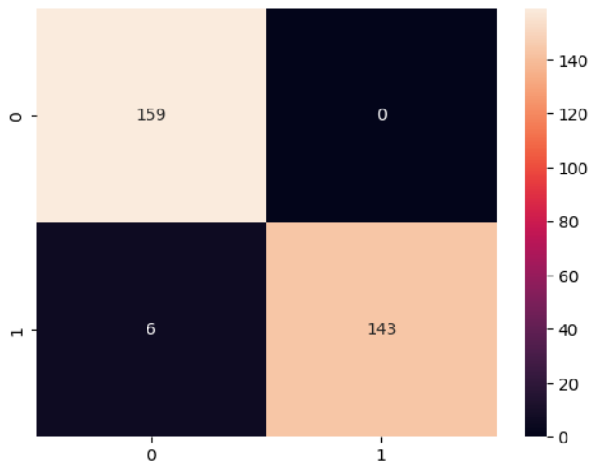
Best Model
Random Forest (RM):
accuracy (~98%)
precision (1.00)
F1 score (0.97)
recall (0.95)
Slightly higher runtime (~0.11s), but worth it given the performance.
The model shows near-perfect precision with high recall, meaning it's both precise and sensitive — an ideal combination.

Slide 20
Project analysis slide 3
Conclusion
Research Achievements:
Developed a high-performing ensemble model for heart disease prediction.
Achieved significant improvements over existing methodologies.
Healthcare Impact:
Facilitates early diagnosis and reduces mortality.
Applicable in underserved regions with limited medical resources.
Final Takeaway:
Machine learning can transform medical diagnostics, offering scalable and efficient solutions to global health challenges.
Clinical Impact
The study supports the development of intelligent healthcare systems for timely diagnosis and intervention in cardiovascular disease.

Slide 21
Project analysis slide 3
Future Directions
Exploration of Larger Datasets:
Extend the model to larger and more diverse datasets for improved generalizability.
Integration of Deep Learning:
Incorporate advanced deep learning techniques to enhance prediction accuracy.
Real-World Implementation:
Pilot the framework in clinical settings for practical validation.
Continuous Improvement:
Adapt the model with additional features and real-time data integration.

Slide 22
Project analysis slide 3
References
[1] Ogunpola, A., Saeed, F., Basurra, S., Albarrak, A. M., & Qasem, S. N. (2024). Machine
Learning-Based Predictive Models for Detection of Cardiovascular Diseases. Diagnostics, 14(2), 144. https://doi.org/10.3390/diagnostics14020144
[2] Reddy, K. V. V., Elamvazuthi, I., Aziz, A. A., Paramasivam, S., Chua, H. N., &Pranavanand, S. (2021). Heart Disease Risk Prediction Using Machine Learning Classifiers with Attribute Evaluators. Applied Sciences, 11(18), 8352. https://doi.org/10.3390/app11188352
[3] Bhowmik, P. K., Miah, M. N. I., Uddin, M. K., Sizan, M. M. H., Pant, L., Islam, M. R., & Gurung, N. (2024). Advancing Heart Disease Prediction through Machine Learning: Techniques and Insights for Improved Cardiovascular Health. British Journal of Nursing Studies, 4(2), 3550.
[4] Qadri, A. M., Raza, A., Munir, K., & Almutairi, M. S. (2023). Effective feature engineering technique for heart disease prediction with machine learning. IEEE Access, 11, 56214-56224.
[5] C. A. Uslan, J. Iqbal, R. Irfan, S. Hussain, A. D. Algarni, S. S. H. Bukhari, N. Alturki, and S. S. Ullah, "Effectively predicting the presence of coronary heart disease using machine learning classifiers," Sensors, vol. 22, no. 19, p. 7227, Sep. 2022.
[6] R. Katarya and S. K. Meena, "Machine learning techniques for heart disease prediction: A comparative study and analysis," Health Technol., vol. 11, no. 1, pp. 87–97, Jan. 2021.
[7] P. Rani, R. Kumar, N. M. O. S. Ahmed, and A. Jain, "A decision support system for heart disease prediction based upon machine learning," J. Reliable Intell. Environ., vol. 7, no. 3, pp. 263–275, Sep. 2021.
[8] Mohan, S., Thirumalai, C., & Srivastava, G. (2019). Effective heart disease prediction using hybrid machine learning techniques. IEEE access, 7, 81542-81554.

Slide 23
Thank You We are looking for questions.

